Slide 1


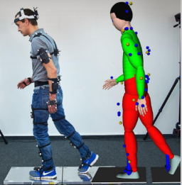
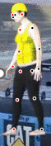
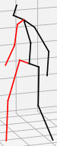



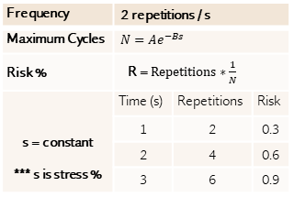
Vision-Based Ergonomic Cumulative Damage Assessment
Objectives
Understand the respective working behaviour of beginner and expert using cumulative damage risk assessment.
Understand the reliability of vision-based pose estimation compared to marker-based pose estimation for cumulative damage risk assessment.
Background
Conventional non-cumulative risk assessment consistently classifies postures into the same categories (high-risk or low-risk). However, in cumulative damage risk assessment, risk possibility is a function of repetitions and time at a constant stress.
Frequency | 2 repetitions / s
Maximum Cycles | $$N=Ae^{−Bs}$$
Risk % | R = $Repetitions∗\frac{1}{N}$
s = constant *** s is stress % | Time (s) | Repetitions | Risk
 | 1 | 2 | 0.3
 | 2 | 4 | 0.6
 | 3 | 6 | 0.9
Risk
t2
Risk
0.9
t3
t1
0.9
Cumulative
0.6
0.6
Non- Cumulative
0.3
Damage per Repetition
0.3
Time/ Number of Repetitions
0.02
t1
t2
t3
Non-cumulative method treats every cycle independently, cumulative method considers the previous repetitions
Marker-based technique has more complex set up, but vision-based technique based only on image features
Marker-based
Suit is required
Marker-less
Suit is not required
Repeat the Experiment of the Reference Paper
Method
1
VideoPose3D 3D Pose Estimation
2
Cumulative Damage for Low Back and Shoulder
3
Risk Possibility
Expected Findings
4
It is possible to classify low-risk postures determined by conventional non-cumulative risk assessment as high-risk postures by using cumulative damage risk assessment.
Vision-based pose estimation is reliable enough compared to marker-based technique as the error is negligible when adopted for cumulative damage risk assessment.
Data Needed
Data collected in the paper:
(Ryu et al. 2023) Ergonomic characteristics of expert masons
(Ryu et al. 2020) Relationships between body load and training, work methods, and work rate
***More Details：Stress_and_Risk_Probability_Calculation.pptx

